Slide 1
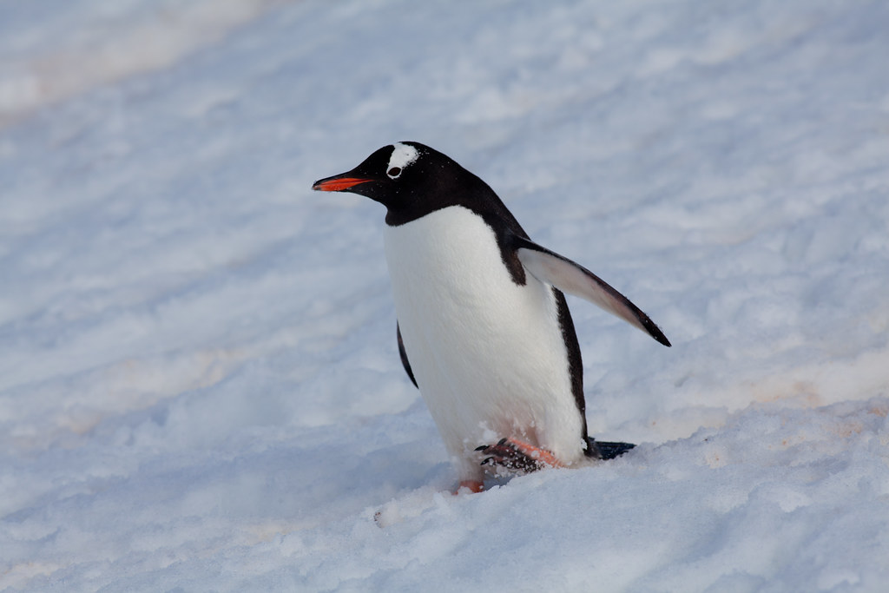
Palmer Penguins
Data collected by: Kristen Gorman
Last update: 2009
Presented by: Carlos Reyes
Esta foto de Autor desconocido está bajo licencia CC BY-SA-NC

Slide 2
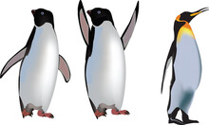
Table of Contents
Introduction
Summary of Values
Analysis
Conclusion

Slide 3
Introduction
This project explores the detailed data gathering efforts of Dr. Kristen Gorman, with an emphasis on body measurements of three different species of penguins living on different islands in the Palmer Archipelago in Antarctica. Our goal is to sort through this extensive information in order to find any possible relationships between the physical characteristics of these penguins, with a focus on investigating the possible effects of body mass on the dimensions of their bills and the length of their flippers.

Slide 4
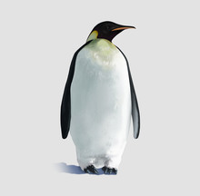
Summary of Values
Mean and max values calculated for bill length, bill depth, and flipper length.

Slide 5
Summary of Values
Species | Mean Bill Length (meters) | Max Bill Length (meters) | Mean Bill Depth (meters) | Max Bill Depth (meters) | Mean Flipper Length (meters) | Max Flipper Length (meters) | Mean Body Mass (kg) | Max Body Mass (kg)
Adelie | 0.0388 | 0.046 | 0.0183 | 0.0215 | 0.190 | 0.21 | 3.71 | 4.78
Chinstrap | 0.0488 | 0.058 | 0.0184 | 0.0208 | 0.196 | 0.212 | 3.73 | 4.8
Gentoos | 0.0476 | 0.0596 | 0.0150 | 0.0173 | 0.217 | 0.231 | 5.09 | 6.3

Slide 6
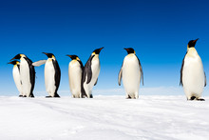
Analysis
Comparing each of the measurements with body mass to determine a relationship

Slide 7
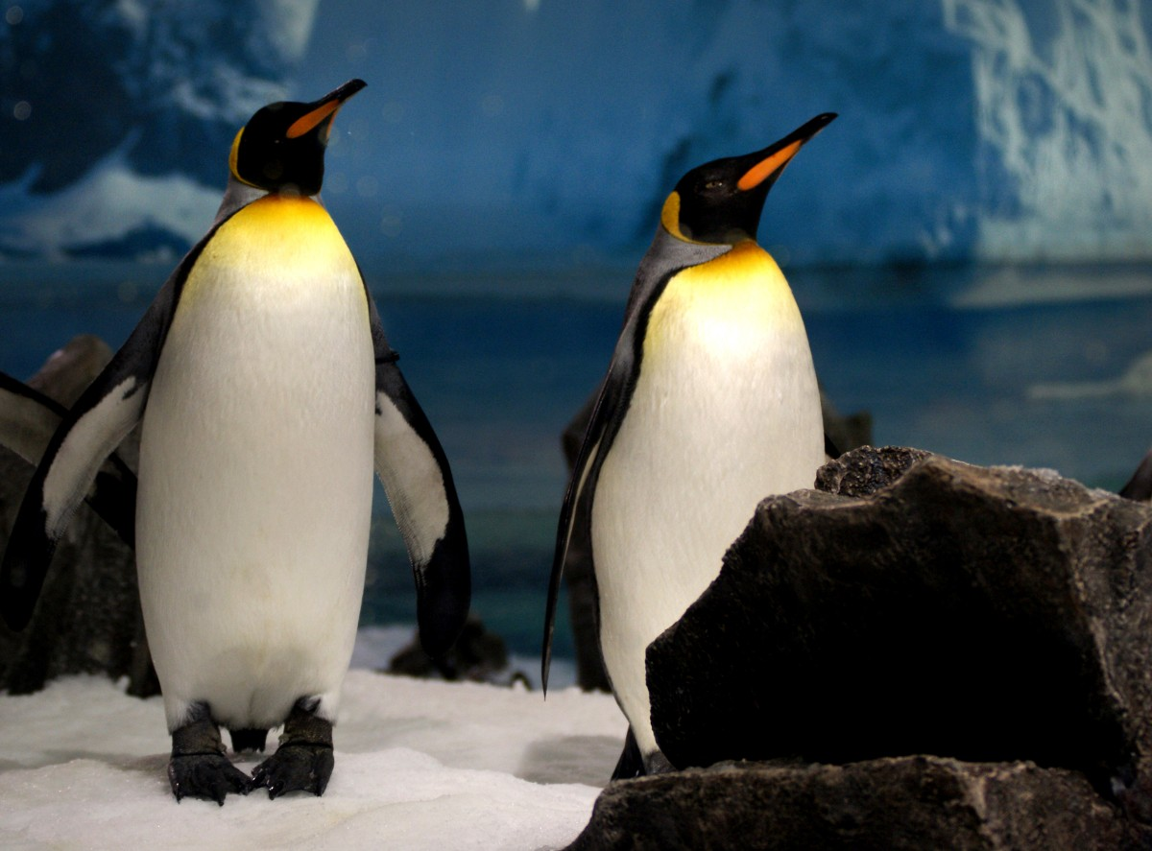
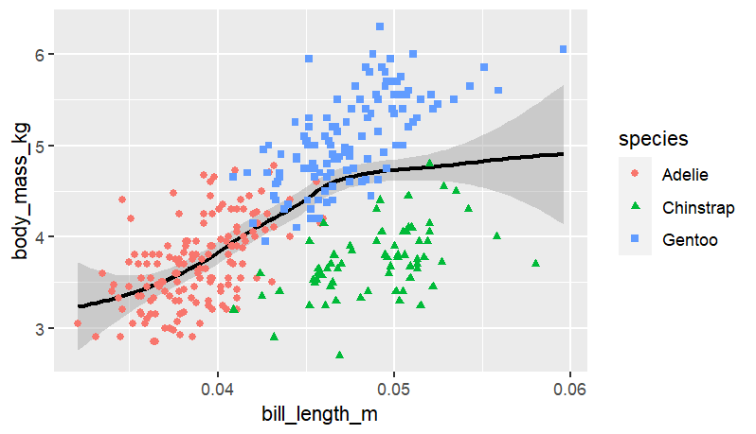
Bill Length vs Body Mass
As the penguin’s body mass increases, its bill length tends to increase.
There seems to be a significant relationship between the bill length and the body mass.

Slide 8
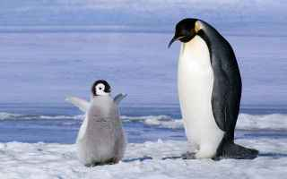
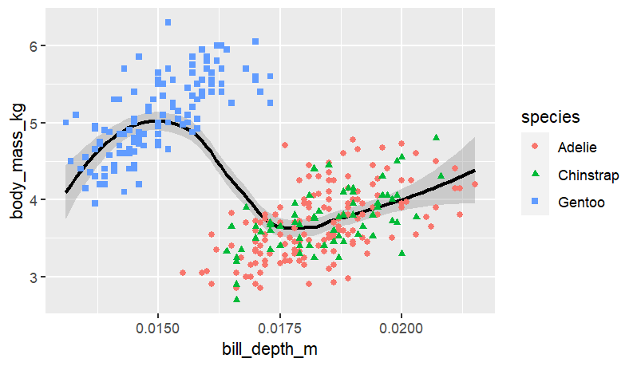
Bill Depth vs Body Mass
The Gentoo species tends to have a greater body mass and a larger bill depth than the other species.
Nevertheless, further research is going to be needed to determine a relationship between bill depth and body mass.

Slide 9
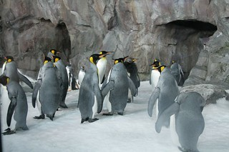
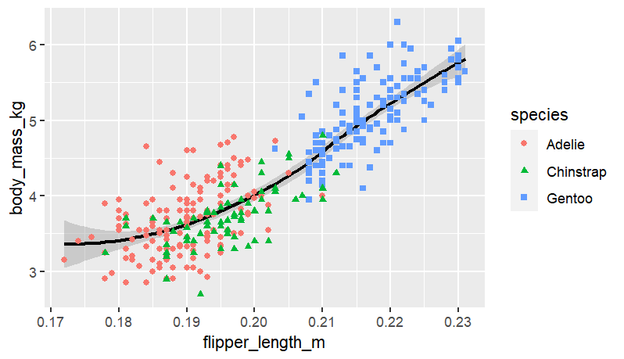
Flipper Length vs Body Mass
As the penguin’s body mass increases, so does its flipper length.
There is a direct relationship between the flipper length and the body mass.

Slide 10
Conclusion
Patterns and relationships were discovered through the examination of physical traits and geographic distribution that not only improve our knowledge of these species but also support more extensive ecological research and conservation initiatives. This dataset is an important educational tool that supports experiential learning and motivates more study of environmental science and biodiversity.

Slide 11
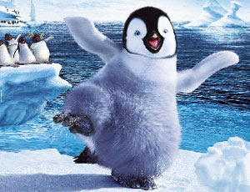
Thanks For Your Attention
Esta foto de Autor desconocido está bajo licencia CC BY-NC-ND

